Slide 1
Presentation Agenda : House pricing High Level Prediction Data Scientists : Nasim,Satheesh,Sandeep
Introduction
Data Cleaning and Visualization
Poster Presentation

Slide 2
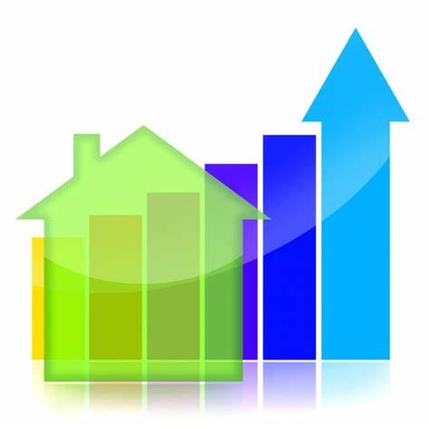



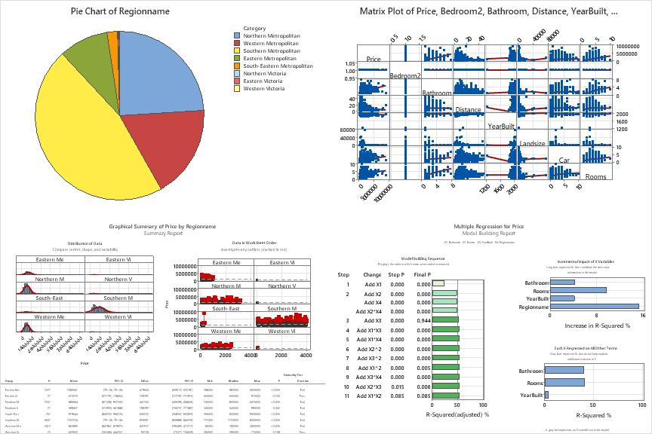
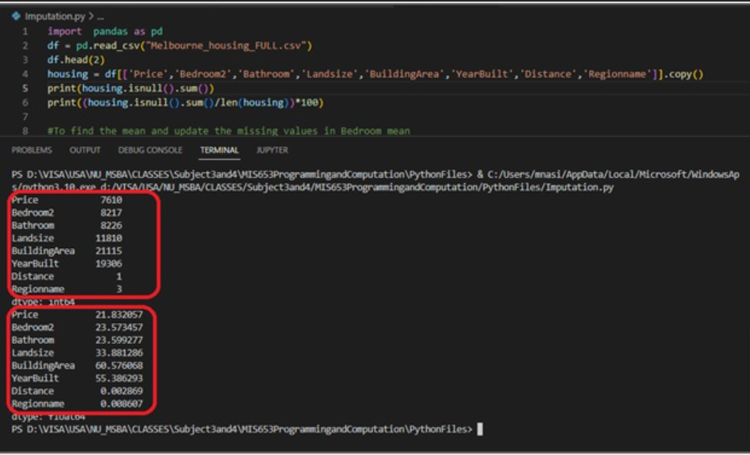
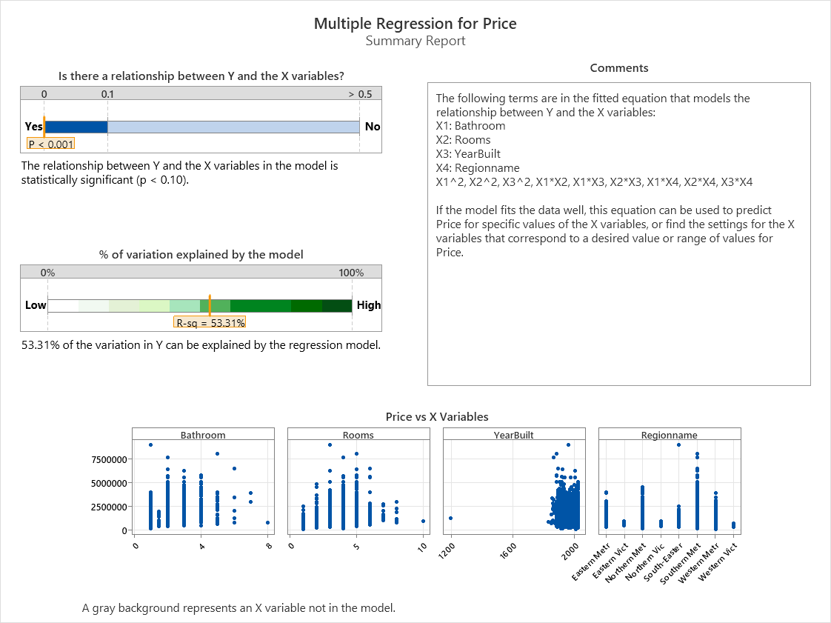
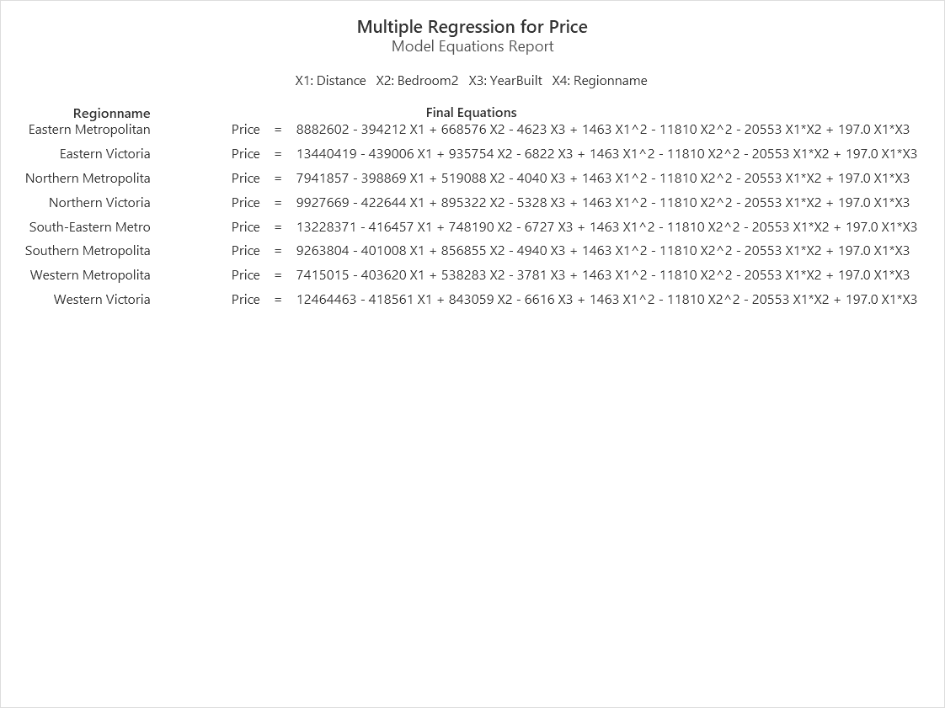
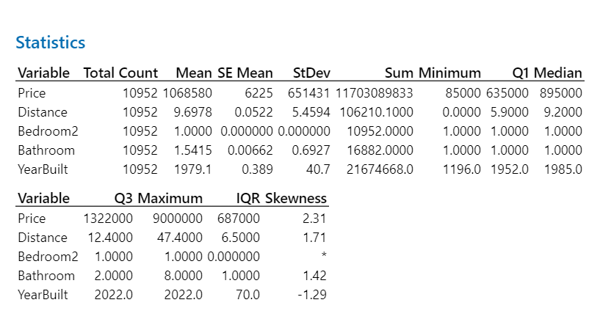
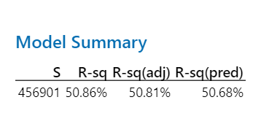
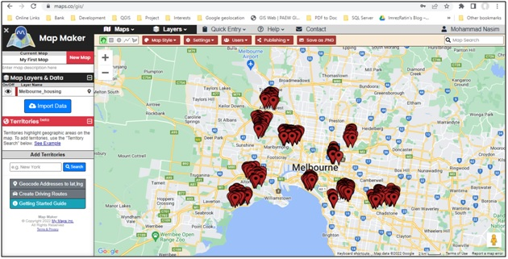
Business Analytics - House pricing High Level Prediction Prof. Dr. Itauma,Itauma
Data Scientists : Nasim,Satheesh,Sandeep
Introduction:To predict housing price for maximum of about three bedrooms apartments in Melbourne,Australia by regionwise.Here cosidered the hypothesis can discussed about distance,year of built,no. of bedrooms with integrated washrooms as well as overall occupancy size.
Refining Method: Imputation for data completeness and here records having 25% missing data removed fron the raw dataset.
Data Analysis
Conclusion: Based on statistical evaluation ,southern Metropolitan region have highest pricing in terms of number of rooms with integrated washroom as well as distance and age of the building have less significant in Melbourne, Australia.
Reference :
https://www.hindawi.com/journals/acisc/2022/1562942/
https://www.researchgate.net/publication/348604535_Empirical_analysis_of_regression_techniques_by_house_price_and_salary_prediction
https://ieeexplore.ieee.org/document/8473231

